Slide 1

School exercise:
PEEL Paragraph

Slide 2
What is ‘PEEL’?

Slide 3
PEEL is a writing structure that helps you argue a point clearly and convincingly.

Slide 4
PEEL is a writing structure that helps you argue a point clearly and convincingly.
What is a POINT?
A point is your main argument or opinion about a topic.
German: These / Behauptung / Standpunkt

Slide 5
Elements of a PEEL paragraph:
P = POINT - State your main argument

Slide 6
Elements of a PEEL paragraph:
P = POINT - State your main argument
E = EVIDENCE/EXAMPLE - Give proof or an example

Slide 7
Elements of a PEEL paragraph:
P = POINT - State your main argument
E = EVIDENCE/EXAMPLE - Give proof or an example
E = EXPLANATION - Explain how your example supports your point

Slide 8
Elements of a PEEL paragraph:
P = POINT - State your main argument
E = EVIDENCE/EXAMPLE - Give proof or an example
E = EXPLANATION - Explain how your example supports your point
L = LINK - Connect back to your original point

Slide 9
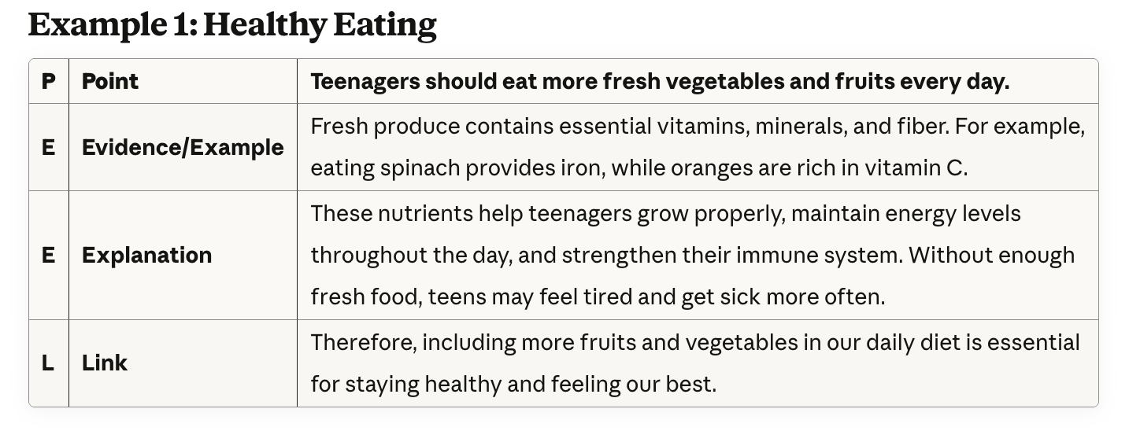

Slide 13
YOUR TURN: Write a PEEL paragraph yourself!

Slide 14
YOUR TURN: Write a PEEL paragraph yourself!
1) CBp.59, Task 13
Use your notes from yesterday’s discussion with your neighbor
Choose ONE situation
a) maintain weight/tired
b) muscle mass/vegetarian
c) lose weight/no veggies
d) eat healthily
→ Give advice to that friend using PEEL

Slide 15
YOUR TURN: Write a PEEL paragraph yourself!
1) CBp.59, Task 13
Use your notes from yesterday’s discussion with your neighbor
Choose ONE situation
a) maintain weight/tired
b) muscle mass/vegetarian
c) lose weight/no veggies
d) eat healthily
→ Give advice to that friend using PEEL
2) CBp. 60, Task 14
From the "Charge up with healthy eating" text:
Choose ONE piece of advice you find hard to follow: fruits/veggies • whole grains • protein • dairy • fats • sodium • sugar • fast food
→ You can start with: "I know it's important to..., but I..."
→ Explain your disagreement using PEEL

Slide 16
YOUR TURN: Write a PEEL paragraph yourself!
1) CBp.59, Task 13
Use your notes from yesterday’s discussion with your neighbor
Choose ONE situation
a) maintain weight/tired
b) muscle mass/vegetarian
c) lose weight/no veggies
d) eat healthily
→ Give advice to that friend using PEEL
2) CBp. 60, Task 14
From the "Charge up with healthy eating" text:
Choose ONE piece of advice you find hard to follow: fruits/veggies • whole grains • protein • dairy • fats • sodium • sugar • fast food
→ You can start with: "I know it's important to..., but I..."
→ Explain your disagreement using PEEL
3) CBp.61, Task 16
Use your notes from today’s discussion with your neighbor
Choose ONE question:
1) other healthy tips?
2) encourage healthy eating?
3) young people eat unhealthy?
→ Answer it with your opinion using PEEL

